Slide 1

FROZEN LAKE GAME USING Q-LEARNING
21AIE311 - REINFORCEMENT LEARNING
Guided By Dr. Amudha J
TEAM 4 - INFINITY
APOORVA M - BL.EN.U4AIE19007
TANUJ M - BL.EN.U4AIE19041
AISHWARYA V - BL.EN.U4AIE19068

Slide 2
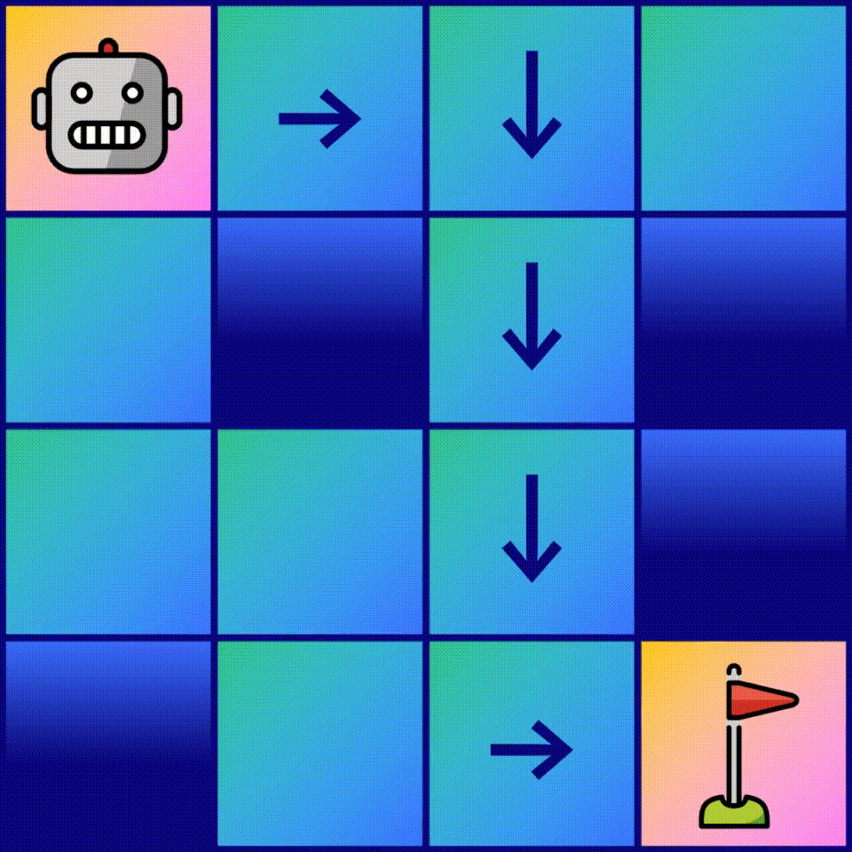
PROBLEM STATEMENT
We have implemented Frozen Lake game using Reinforcement Learning.
In the game, the agent controls the movement of a character in a 4x4 (16 Tiles) grid world.
The agent must begin at the start tile in Frozen Lake and reach the goal tile.
Some tiles are ‘‘frozen,’’ and the agent can walk over them; other tiles have ‘‘holes.’’ If the agent steps on a hole tile, it falls and dies.
Additionally, the movement direction of the agent is uncertain and only partially depends on the chosen direction.
The agent is rewarded for finding a walkable path to goal tile.

Slide 3
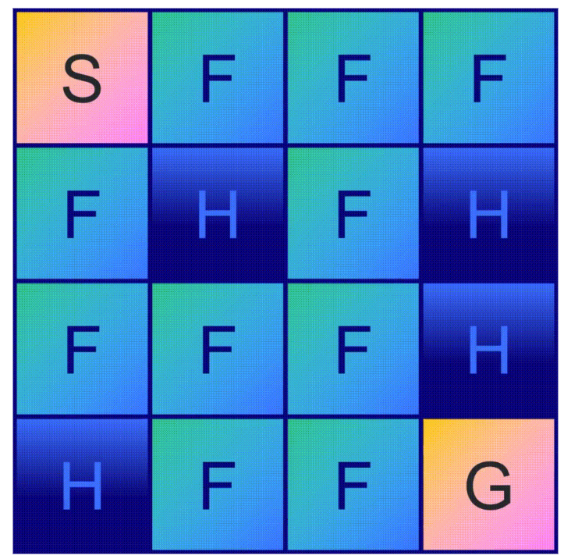
RL FORMULATION
Goal: The agent must learn to avoid holes in order to reach the goal in a minimal number of actions.
Environment: A 4x4 grid composed of tiles
State Space: In Frozen Lake, there are 16 tiles, which means our agent can be found in 16 different positions.
S is the starting state
F is the frozen states
H is the hole states
G is the goal state

Slide 4
RL FORMULATION
Action Space: For each state, there are 4 possible moves:
◀️LEFT, 🔽DOWN, ▶️RIGHT, and 🔼UP.
Reward: The agent gets a reward of +1 when it reaches the goal tile, and, at all other times, there is a 0 reward.
Policy: The epsilon is picked at random, and the playing philosophy is e-greedy.
ε-Greedy Policy: A greedy policy means the Agent constantly performs the action that is believed to yield the highest expected reward.

Slide 5
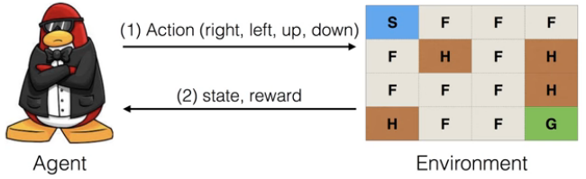
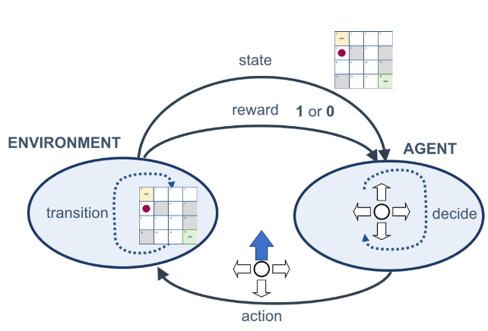
RL MODEL - MDP DIAGRAM

Slide 6
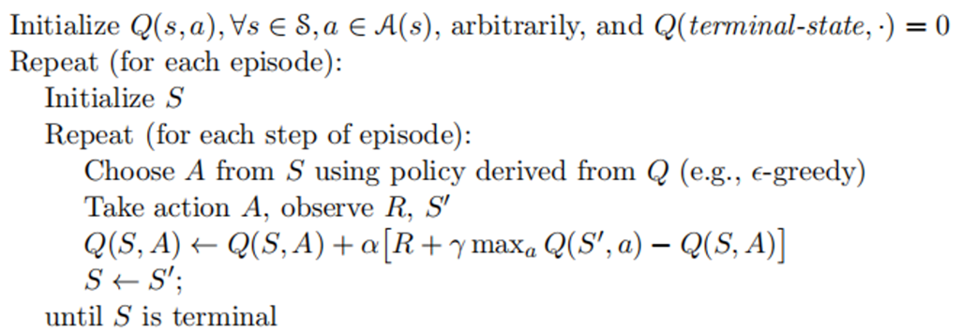
MODEL ARCHITECTURE
Q-LEARNING
Q-learning is an off-policy reinforcement learning algorithm that seeks to find the best action to take given the current state by iteratively improving the behavior of the learning agent using Q-values.
Q-learning seeks to learn a policy that maximizes the total reward.

Slide 7
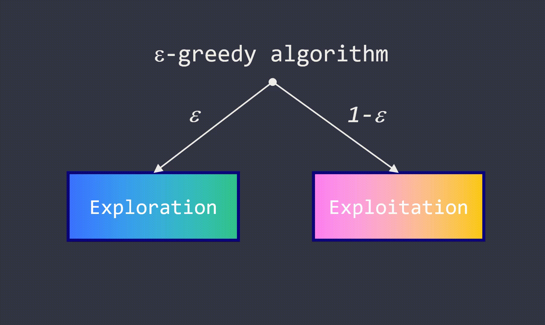
MODEL ARCHITECTURE
EPSILON GREEDY
The Epsilon-Greedy Algorithm makes use of the exploration-exploitation tradeoff by
instructing the computer to explore (i.e. choose a random option with probability epsilon)
and exploit (i.e. choose the option which so far seems to be the best) the remainder of the time.

Slide 8
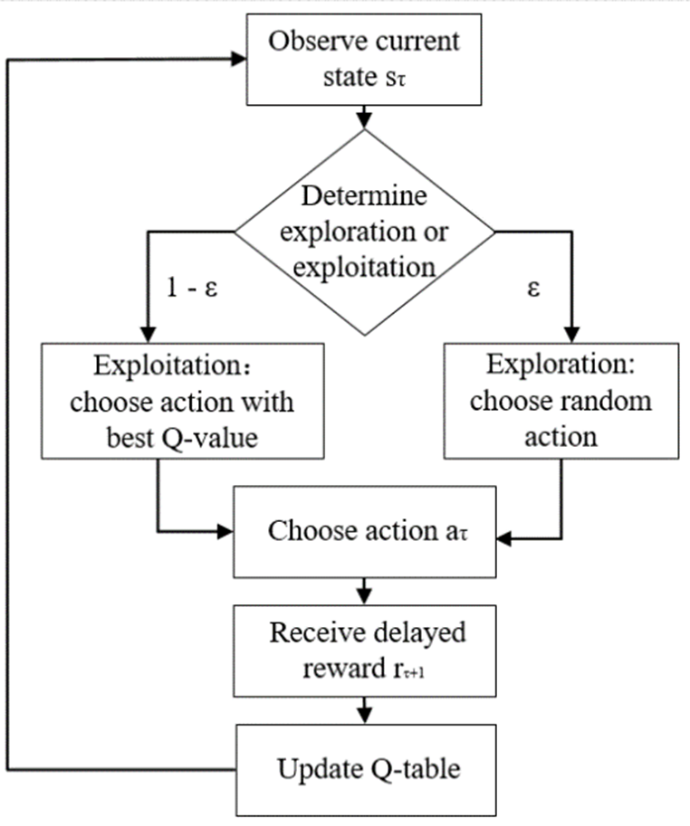

Slide 9
HYPER-PARAMETERS
Learning rate (α)
How much you accept the new value vs the old value.
Gamma (γ)
Is used to balance immediate and future reward. Typically this value can range anywhere from 0.8 to 0.99.
Epsilon (ε)
Exploration and exploitation can be balanced using epsilon.
The value of Epsilon is used to determine how often you want to explore vs exploit.
Epsilon decay
Fixed amount to decrease epsilon overtime.

Slide 10
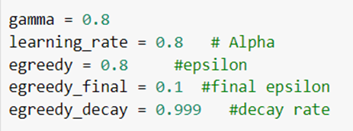
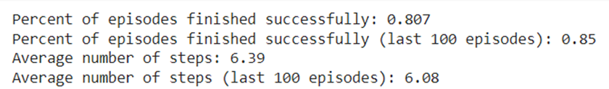
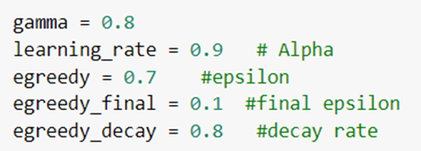
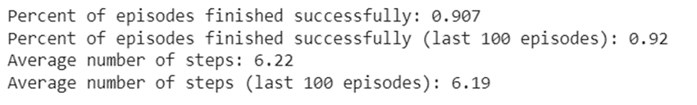
HYPER-PARAMETER TUNING
1000 Episodes

Slide 11
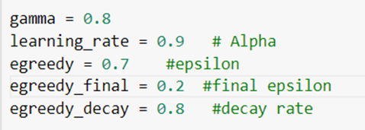
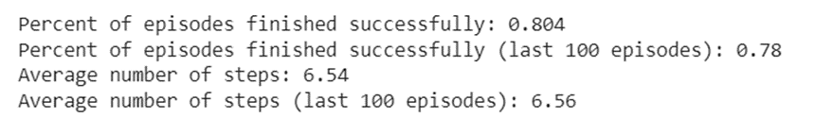
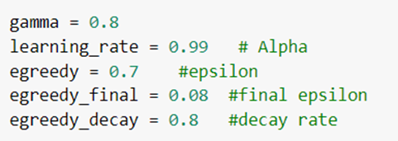
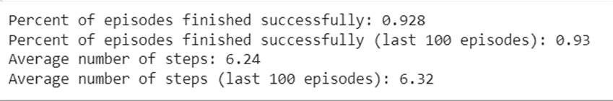
HYPER-PARAMETER TUNING
1000 Episodes

Slide 12
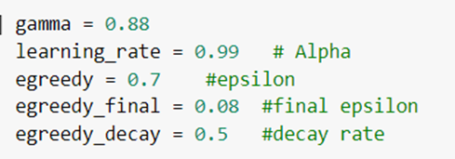
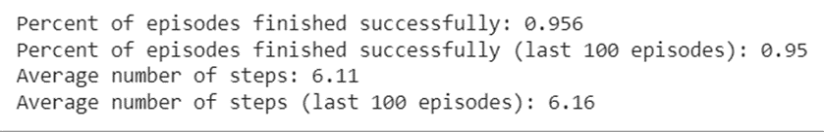
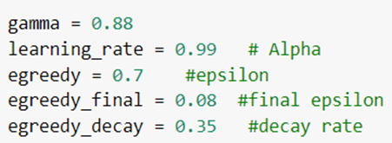
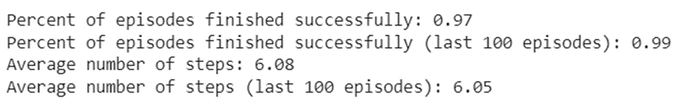
HYPER-PARAMETER TUNING
1000 Episodes

Slide 13
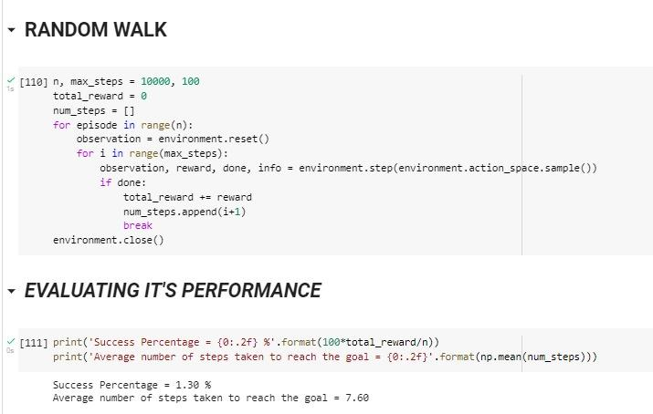
DEMO CODE

Slide 14
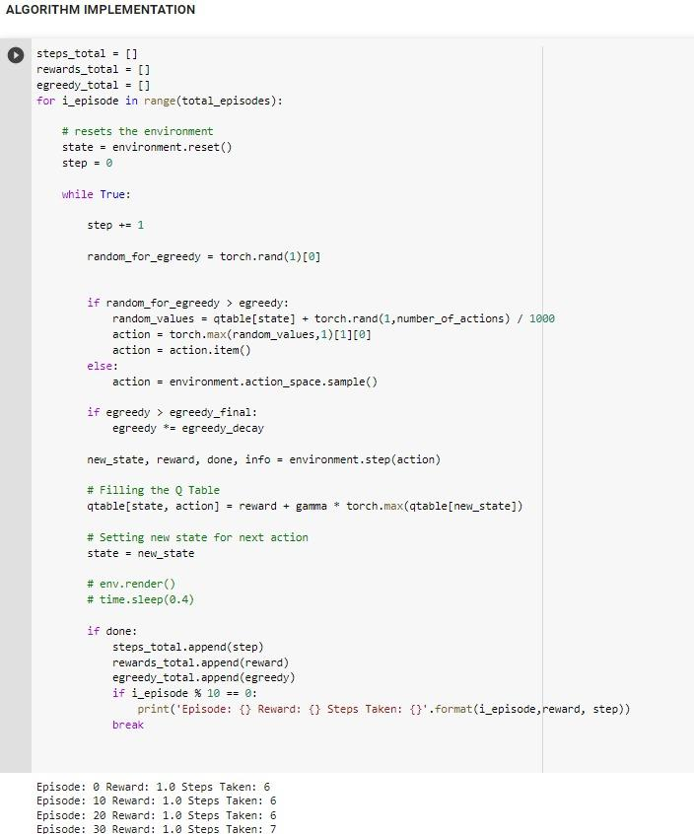
DEMO CODE

Slide 15
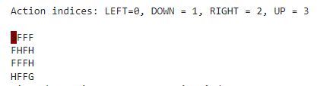
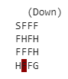
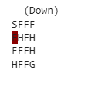
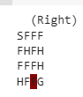
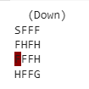
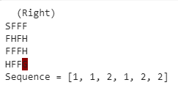
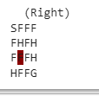
AGENT SIMULATION

Slide 16
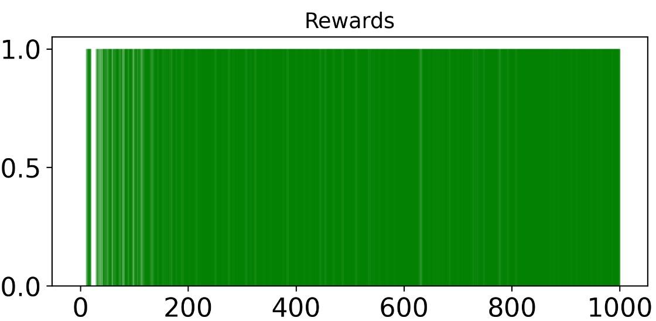
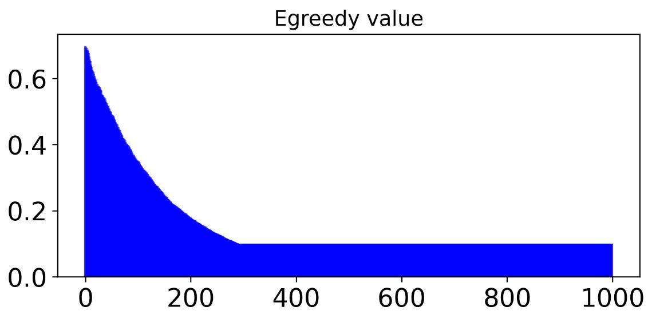
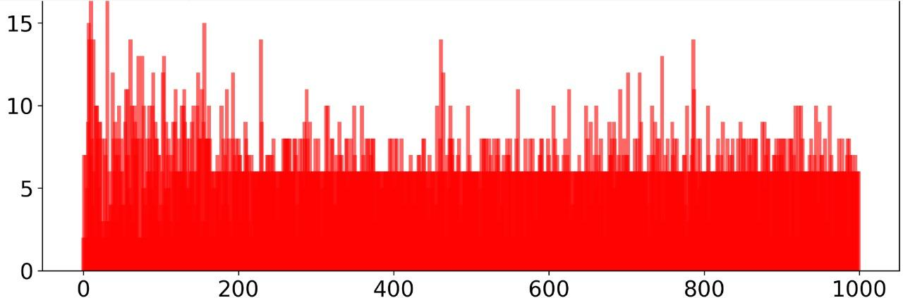
RESULTS
Episodes vs the Rewards obtained at each episode
Steps taken per episode
epsilon value is reducing with time

Slide 17
CONCLUSION
Q-learning is a simple yet powerful algorithm at the core of reinforcement learning. Through this project we learned to interact with the gym environment to choose actions and move our agent;
Created Q-table, where rows are states, columns are actions, and cells are the value of an action in a given state
We experimentally recreated the Q-learning update formula to tackle the sparse reward problem;
We implemented an entire training and evaluation process, that solved the Frozen Lake environment with 96% success rate
We implemented the famous epsilon-greedy algorithm in order to create a tradeoff between the exploration of unknown state-action pairs and the exploitation of the most successful ones.
Most Importantly the Significance of hyper-parameter tuning was understood.

Slide 18
FUTURE SCOPE
The complexity of the game can be increased by changing the dimensions of the game board and
Some more types of reward can be incorporated.
The game can be implemented with various other available algorithms and the performance can be compared according the the complexity of the game and the time taken for computation.

Slide 19
REFERENCES
https://www.researchgate.net/publication/357420847_The_Frozen_Lake_Problem_An_example_of_optimization_policy
https://ieeexplore.ieee.org/stamp/stamp.jsp?arnumber=9558862
https://analyticsindiamag.com/openai-gym-frozen-lake-beginners-guide-reinforcement-learning/

Slide 20
THANK YOU

